Slide 1
Disturbance-Aware Model-Based and Model-Free Zero-Sum Pursuit-Evasion Control
Blaine Christopher Swieder Master of Science in Electrical and Computer Engineering Tennessee Technological University 3 August 2026

Slide 2
Project Roadmap
• Start from one discrete-time zero-sum pursuit-evasion game.
• Compute nominal saddle policies using four established methods.
• Add persistent command-channel offsets at the execution layer.
• Estimate offsets and apply affine compensation.
• Validate convergence, estimator accuracy, compensation, trajectories, and cost in MATLAB.
Nominal zero-sum game
Offset model
Affine compensation
MATLAB validation
Project focus: preserve the original algorithms while testing execution-side command mismatch.

Slide 3
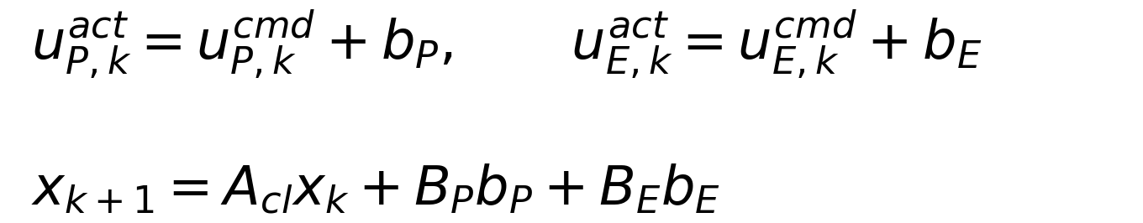
Motivation
• Autonomous and adversarial systems must act while another agent influences the same state.
• Nominal derivations often assume that commanded inputs are applied exactly.
• Persistent actuator or command-channel bias can shift the realized trajectory even when the nominal controller is stable.
• This project separates nominal algorithm validity from realized command behavior.
Nominal assumption
Implementation issue
• commanded input ≠ realized input
• affine forcing changes trajectory
Algorithm convergence alone does not guarantee correct physical execution.

Slide 4
Objective and Scope
Project objective
• extend four established zero-sum methods with the same command-offset model
• estimate persistent offsets using information available to each method
• compare recovery under a common MATLAB protocol
In scope
• two-player discrete-time linear-quadratic game
• model-based GARE PI/VI and model-free Q-learning PI/VI
• constant or slowly varying matched command offsets
Out of scope
• new base PI, VI, or Q-learning algorithms
• nonlinear vehicle or QCar hardware validation
• general fault-tolerant control claims
The contribution is the unified disturbance-aware extension and matched evaluation, not a new base algorithm.

Slide 5
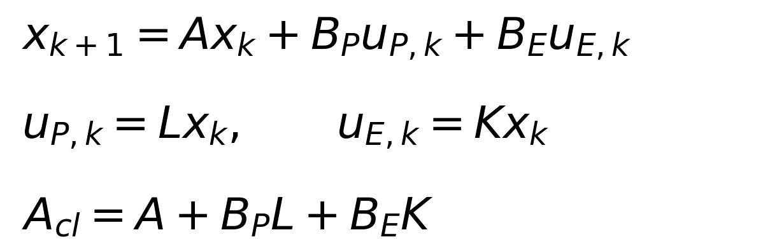
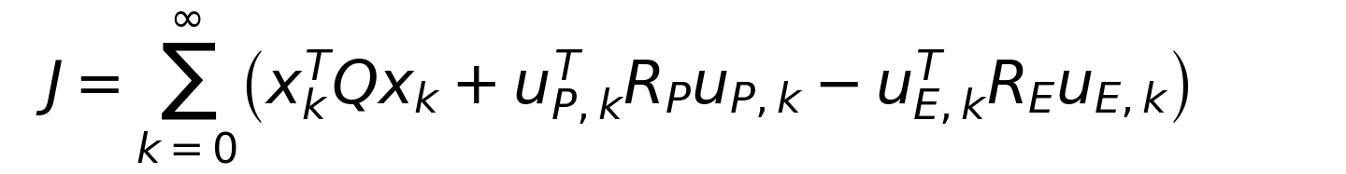
Problem Formulation
• Pursuer input minimizes the quadratic game cost.
• Evader input maximizes the same cost.
• Nominal policies are linear state feedback gains.
• Validity requires closed-loop stability and saddle-point curvature.
All four algorithms solve the same nominal linear-quadratic zero-sum game.

Slide 6
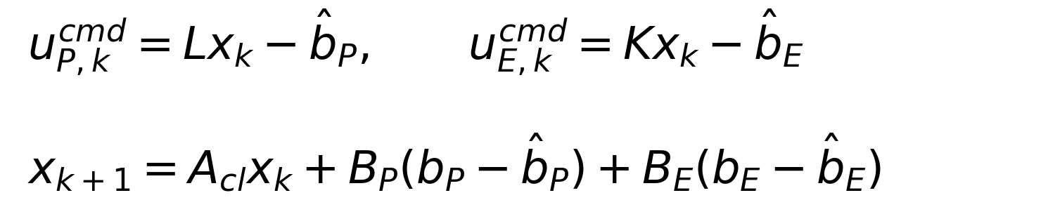
Command-Channel Bias and Compensation
Uncompensated execution
• persistent offsets enter after commands are computed
• nominal gains remain unchanged
• realized dynamics include constant affine forcing
Affine compensation
• subtract estimated offsets from the policy commands
• residual error depends on b minus estimated b
• exact estimates recover nominal closed-loop behavior
The disturbance-aware layer translates commands; it does not rewrite the nominal game.

Slide 7
Four Algorithm Paths
Model-Based
• GARE policy iteration
• GARE value iteration
• known matrices used during nominal computation
• offsets estimated from transition residuals
Model-Free
• quadratic Q-learning policy iteration
• quadratic Q-learning value iteration
• sampled transitions used in Bellman regression
• offsets estimated from command mismatch data
Outer-iteration counts compare numerical paths, not universal runtime or sample complexity.

Slide 8
Validation Protocol
1. Nominal
• zero offsets; reference trajectory and cost
2. Uncompensated
• true offsets enter; no correction
3. Estimated compensation
• estimated offsets subtracted from commands
4. Exact compensation
• true offsets used to verify algebra
• Same system matrices, game weights, offsets, initial condition, and simulation horizon.
• Same reporting structure across GARE and Q-learning methods.
• Exact compensation is a verification case, not a realizable unknown-bias controller.
The four cases isolate nominal convergence, offset damage, practical recovery, and exact verification.

Slide 9
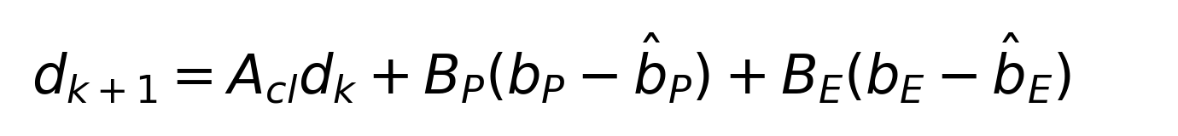
Validation Criteria
Nominal game validity
• value or Q-function convergence
• gain convergence
• GARE, Lyapunov, or Bellman residual
• closed-loop spectral radius
• saddle-point curvature
Data and conditioning
• feature rank for Q-learning
• matrix conditioning
• regression residuals
• estimator rank and conditioning
Execution recovery
• bias-estimation error
• analytical vs simulated deviation
• state and input trajectories
• finite-window game cost
A valid project result must satisfy the game equations and the execution bookkeeping.

Slide 10
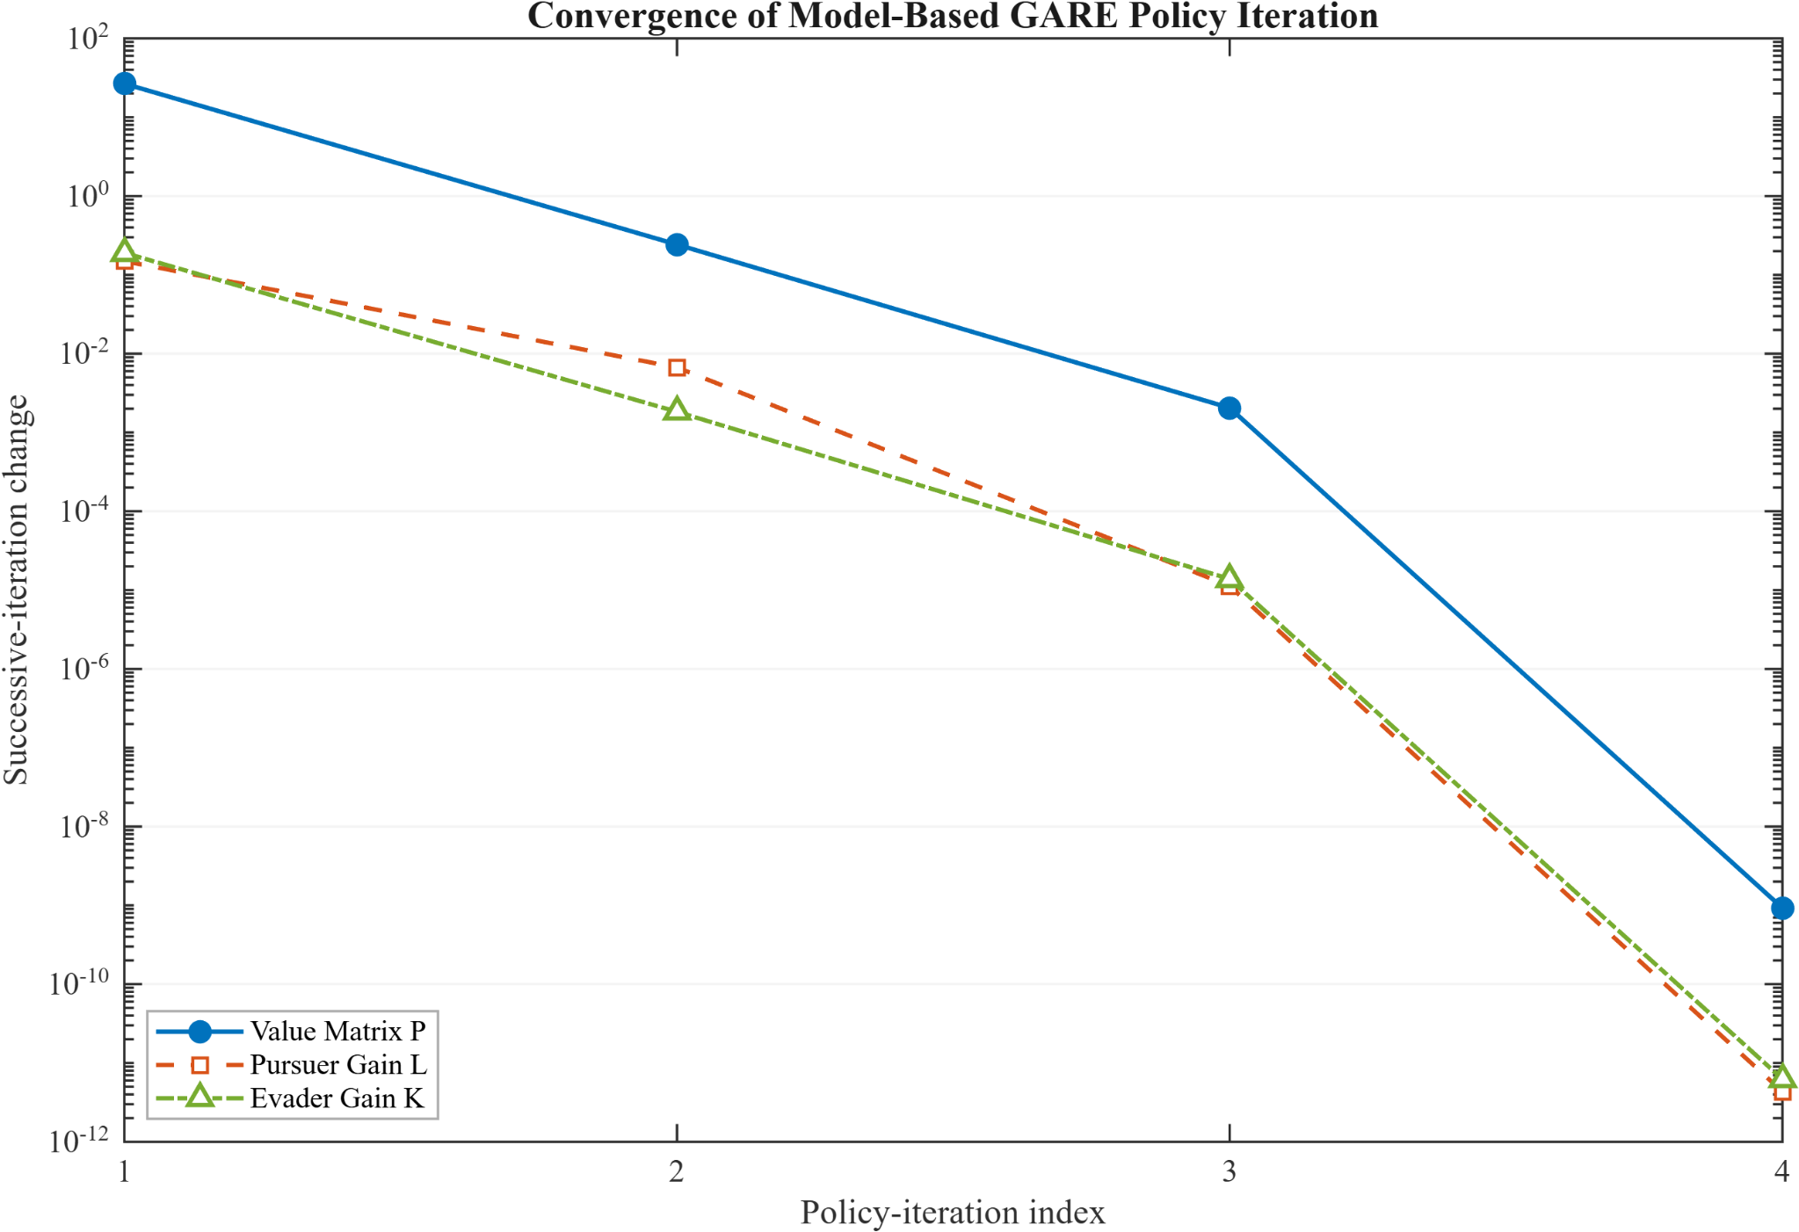
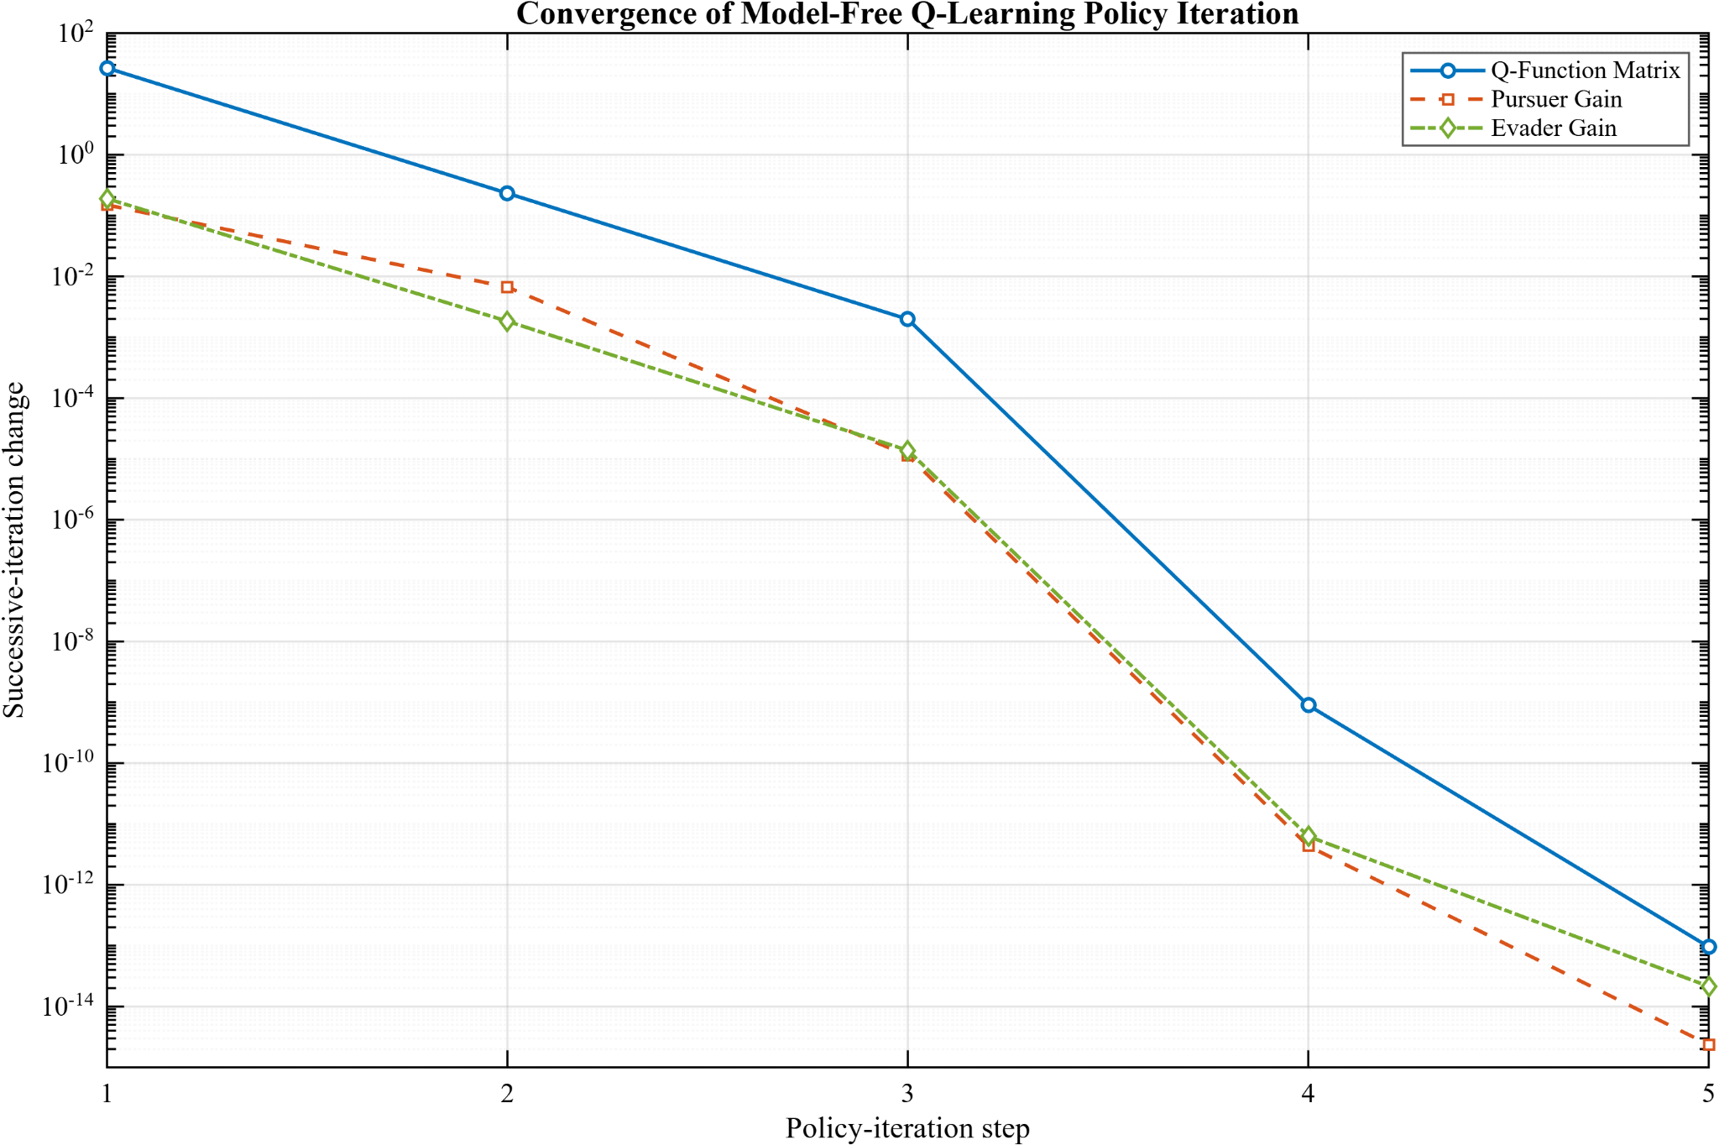
Results: Policy Iteration Convergence
GARE PI: 4 outer updates
Q-learning PI: 5 outer updates
Both policy-iteration methods reach the same nominal saddle solution in a few outer updates.

Slide 11
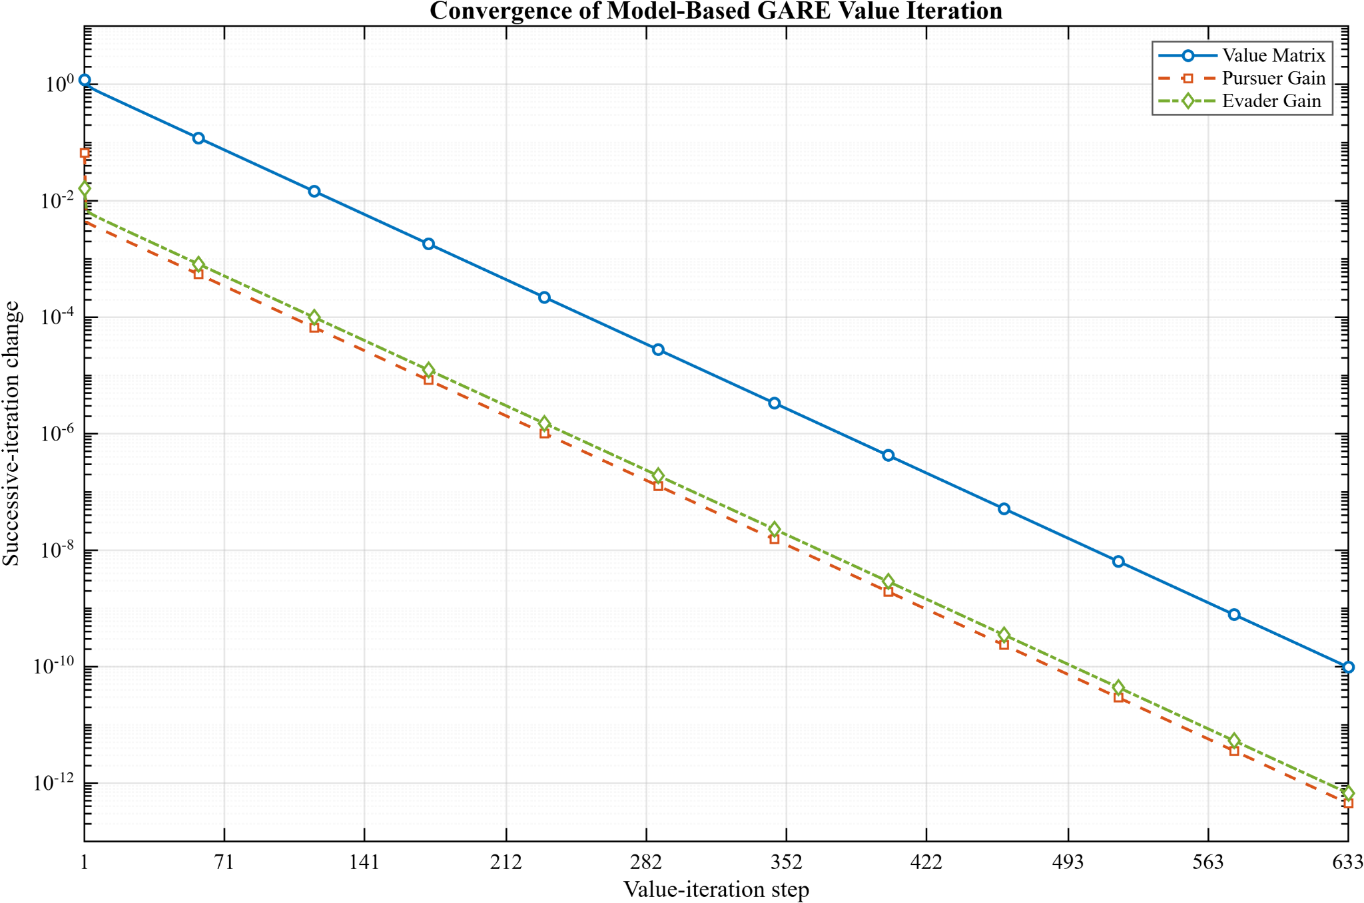
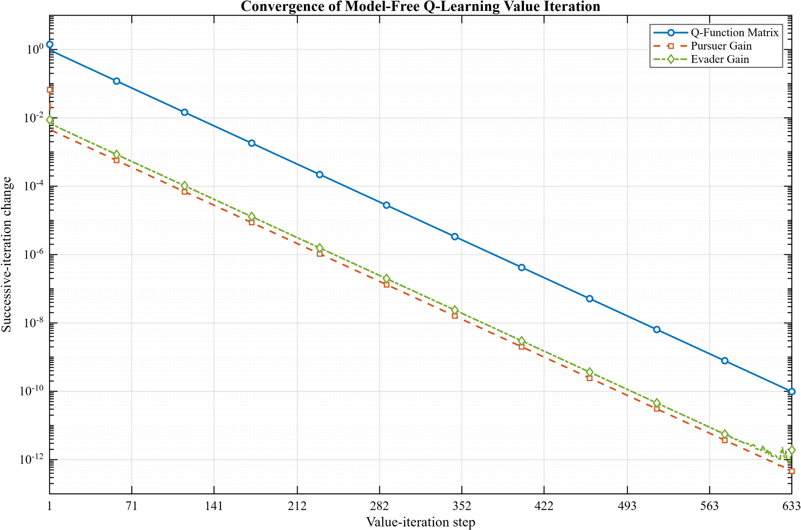
Results: Value Iteration Convergence
GARE VI: 633 value-iteration steps
Q-learning VI: 633 value-iteration steps
Value iteration follows a longer update sequence, but reaches the same final controller.

Slide 12
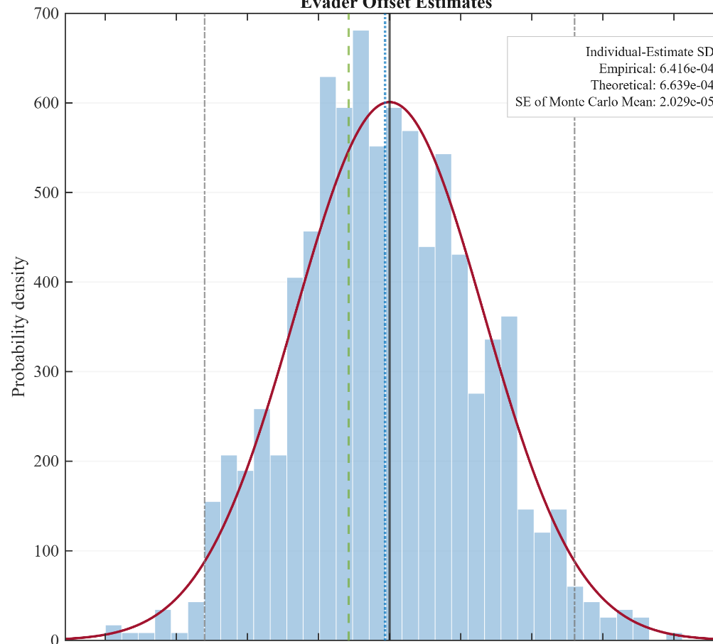
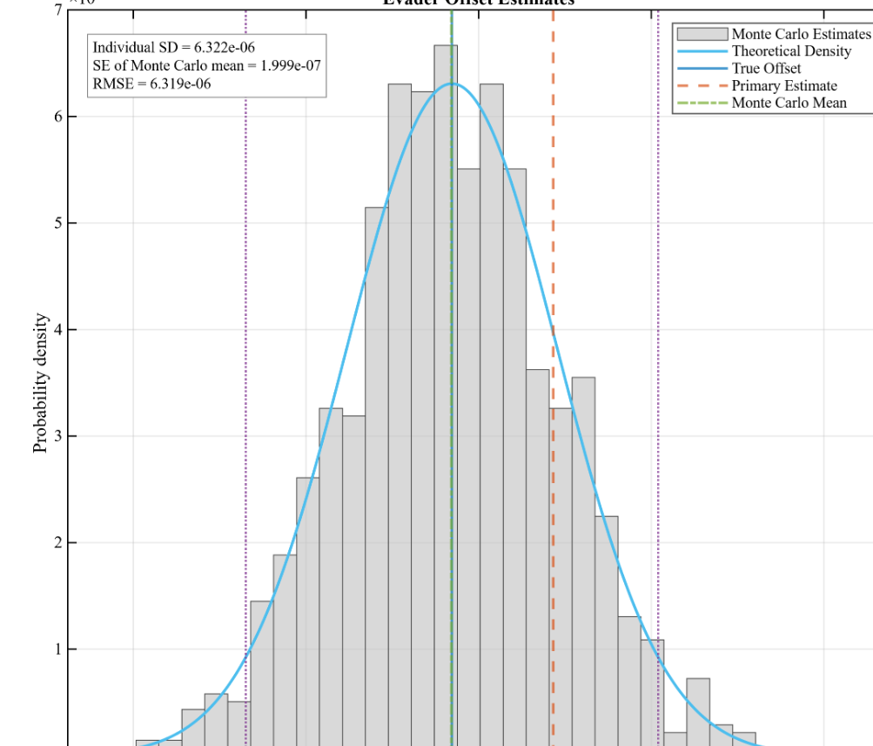
Results: Estimator Information Structure
Known-model residual estimator
Direct command-mismatch estimator
The smaller model-free residual comes from direct channel measurement, not from a better nominal controller.

Slide 13
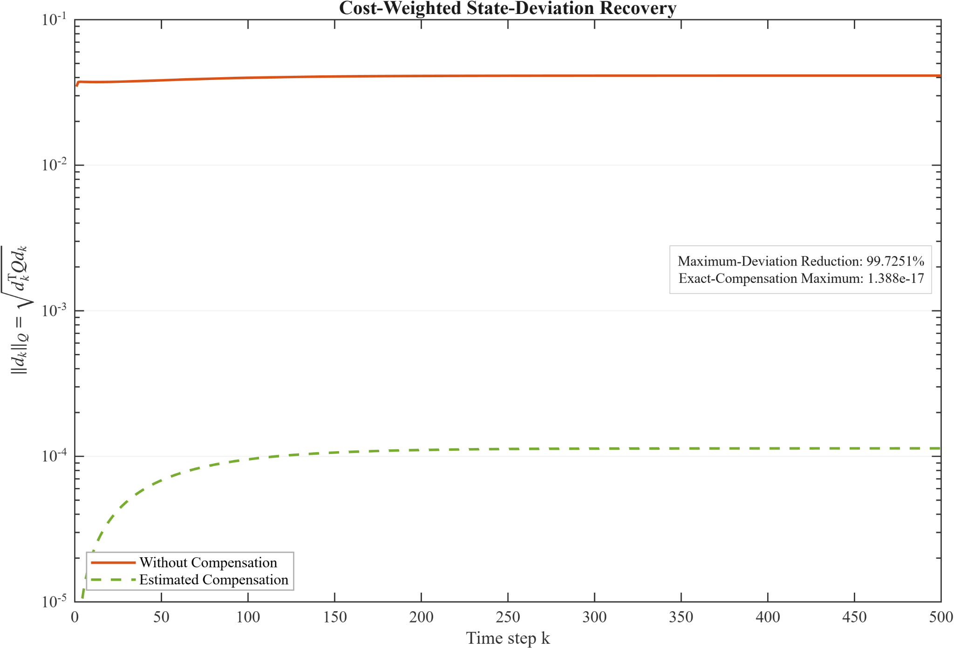
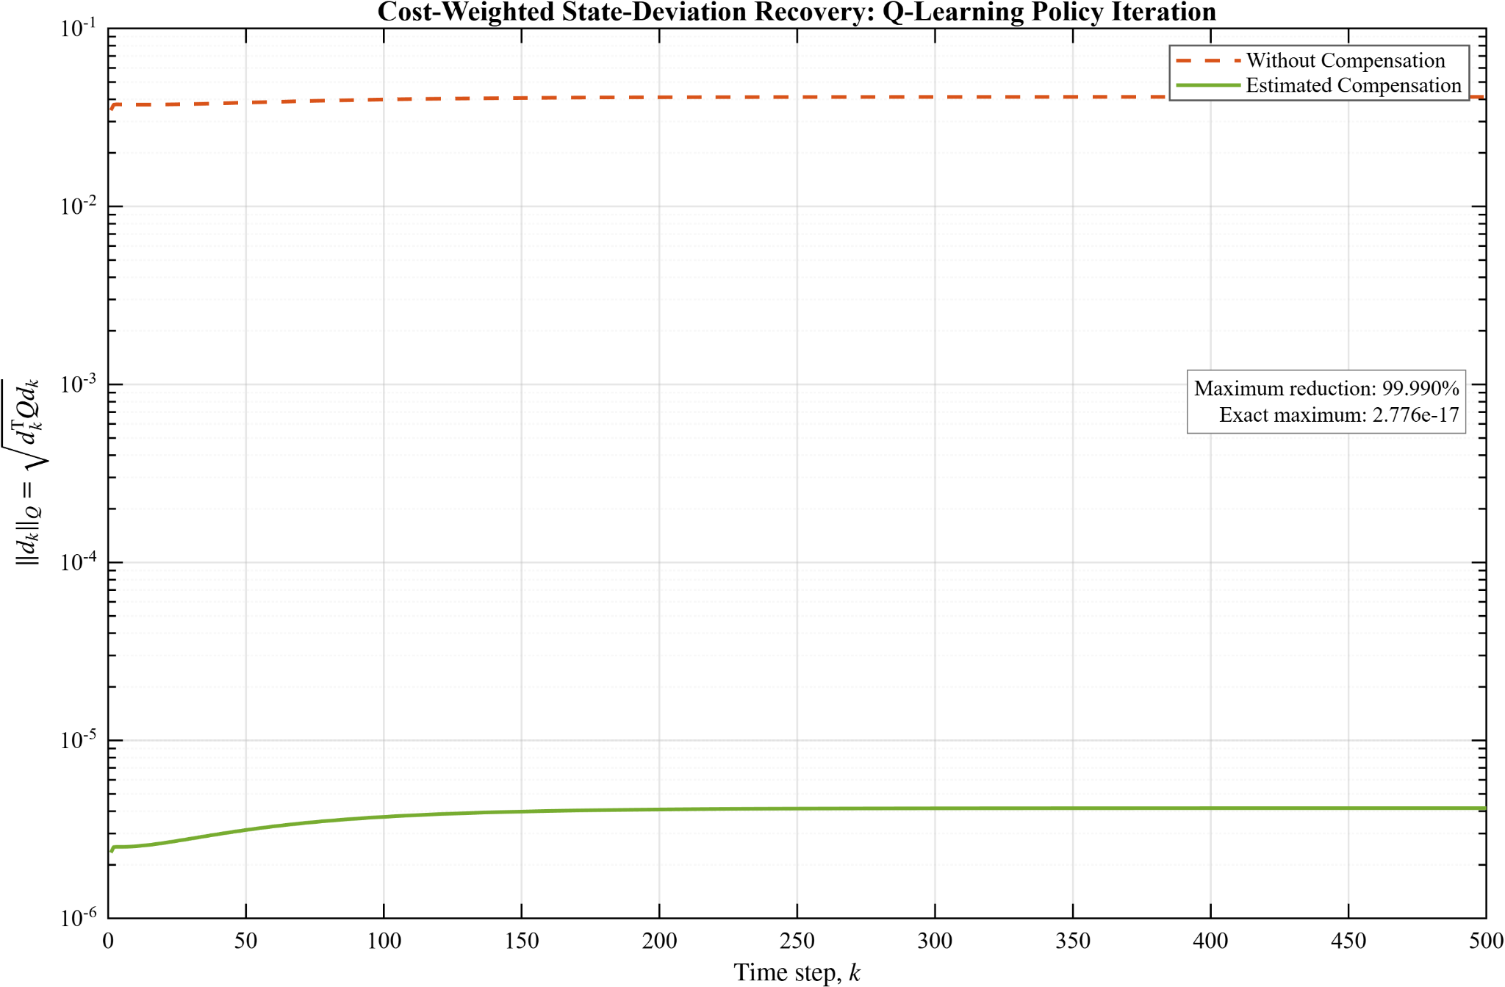
Results: State-Deviation Recovery
Known-model estimator: 99.725% reduction
Direct-mismatch estimator: 99.990% reduction
Uncompensated max deviation ≈ 4.13 × 10⁻²; residual error is governed by estimator accuracy.

Slide 14
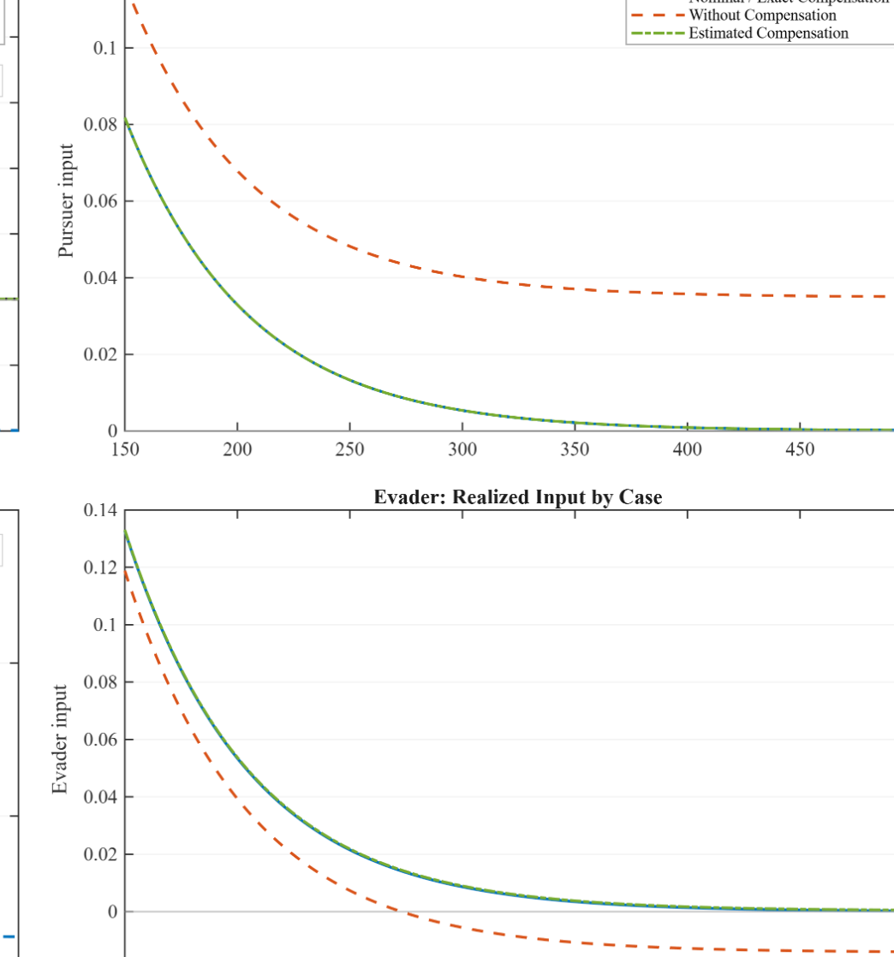
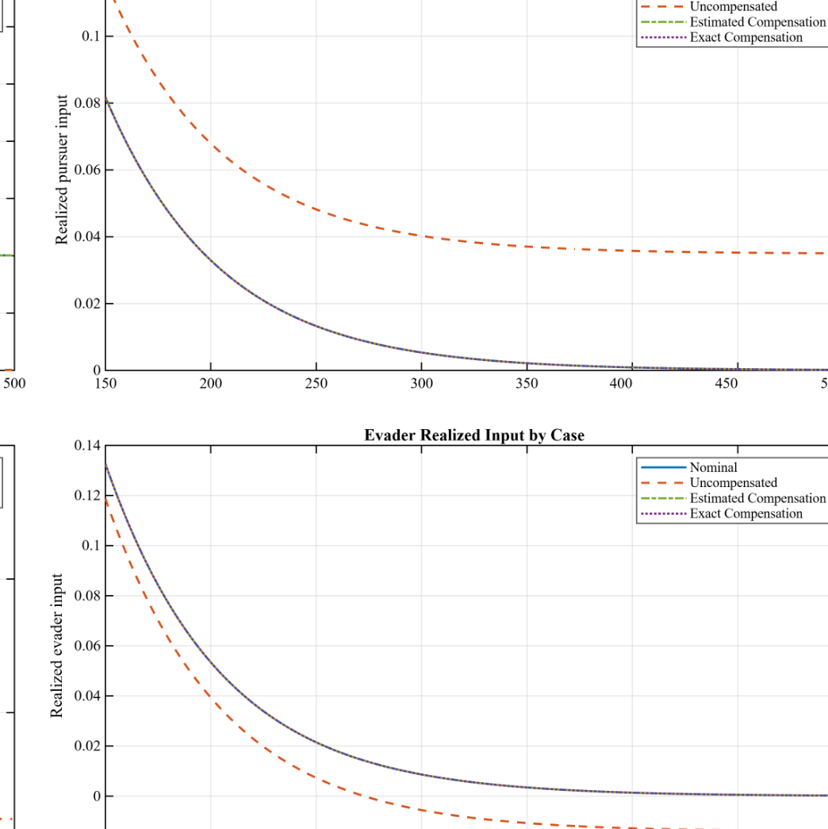
Results: Command-Channel Behavior
Known-model compensation
Direct-mismatch compensation
Compensated commands are shifted so realized inputs nearly overlap nominal/exact behavior.

Slide 15
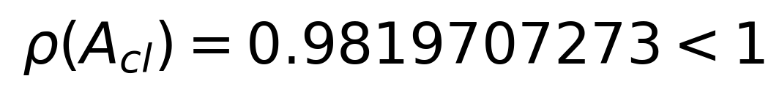
Matched Four-Method Comparison
Method | Steps | Residual | ρ(Acl) | Curvature pair
GARE PI | 4 | GARE | 0.9819707273 | (1.76184, -0.99851)
GARE VI | 633 | GARE | 0.9819707273 | (1.76184, -0.99851)
Q-learning PI | 5 | Bellman | 0.9819707273 | (1.76184, -0.99851)
Q-learning VI | 633 | Bellman | 0.9819707273 | (1.76184, -0.99851)
• All four methods recovered the same stable nominal controller.
• Spectral radius, conditioning, and saddle curvatures agreed to displayed precision.
• Different step counts indicate different numerical paths, not universal speed ranking.
Identical closed-loop stability is the clearest evidence that all four methods reached the same nominal solution.

Slide 16
Main Project Findings
• Nominal agreement: all four methods recovered the same stable saddle solution.
• Offset effect: persistent command offsets changed trajectory and finite-window cost without changing nominal eigenvalues.
• Compensation recovery: estimated affine compensation reduced maximum deviation by 99.725% or 99.990%.
• Estimator distinction: direct command mismatch produced the smallest residual in this benchmark.
• Interpretation: the result is a bounded MATLAB-validated foundation, not a universal algorithm ranking.
Core result
• same nominal game
• same nominal saddle solution
• different estimator information
Estimated compensation: >99.7% deviation reduction
The project shows how to add disturbance-aware execution without replacing the original zero-sum algorithms.

Slide 17
Limitations
Model limitations
• reduced-order linear benchmark
• fully observed, deterministic nominal computation
• not a complete nonlinear vehicle-capture model
Disturbance limits
• constant matched offsets
• no time-varying faults or dead zones
• no saturation or safety filtering
Evidence limits
• offline sufficiently excited Q-learning data
• no complete complexity comparison
• no QLabs or physical QCar validation
The MATLAB evidence is intentionally controlled and should not be overstated as hardware validation.

Slide 18
Future Work
MATLAB foundation
QLabs simulation
Physical QCar
• Replace the reduced benchmark with nonlinear two-vehicle dynamics.
• Generalize scalar offsets to acceleration and steering offset vectors.
• Move from offline calibration to online bias estimation.
• Add output feedback, constraints, saturation, delays, and safety filters.
• Verify command mapping and timing in QLabs before physical QCar tests.
• Extend to multi-pursuer or multi-evader settings after the two-player case is stable.
Future work should extend the validated reduced-order framework rather than skip directly to hardware claims.

Slide 19
?
Questions?
Disturbance-Aware Model-Based and Model-Free Zero-Sum Pursuit-Evasion Control

